Slide 1
Database Systems
Lab 09
Triggers & Transactions

Slide 2
Triggers
A trigger is an event within the DBMS that can cause some code to execute automatically
Triggers are stored programs, which are automatically executed or fired when some events occur.

Slide 3
Events
A database manipulation (DML) statement (DELETE, INSERT, or UPDATE)
A database definition (DDL) statement (CREATE, ALTER, or DROP).
A database operation (SERVERERROR, LOGON, LOGOFF, STARTUP, or SHUTDOWN).

Slide 4
Syntax
CREATE [OR REPLACE] TRIGGER Trigger_name
{BEFORE|AFTER} Triggering_event
ON table_name
[FOR EACH ROW]
[ENABLE/DISABLE]
[WHEN condition]
DECLARE
declaration statements
BEGIN
Executable statements
EXCEPTION
Exception-handling statements
END;

Slide 5
Example
The price of a product changes constantly. It is important to maintain the history of the prices of the products
We can create a trigger to update the table (price_history) when the price of the product is updated in the table (PRODUCT)

Slide 6
Create Tables
CREATE TABLE PRICE_HISTORY (product_id number(5), product_name VARCHAR(20), supplier_name VARCHAR (20), unit_price number(7,2) );
CREATE TABLE PRODUCT (product_id number(5), product_name VARCHAR(20), supplier_name VARCHAR (20), unit_price number(7,2) )

Slide 7
Create Trigger
CREATE OR REPLACE TRIGGER PRICE_HISTORY_TRIGGER
BEFORE UPDATE OR DELETE
ON product
FOR EACH ROW
BEGIN
INSERT INTO PRICE_HISTORY VALUES(:OLD.PRODUCT_ID, :OLD.PRODUCT_NAME, :OLD.SUPPLIER_NAME, :OLD.UNIT_PRICE);
END;
/

Slide 8
Insert and Update Table
Insert into product values (100, ‘Laptop’, ‘Dell’, 262.22); Insert into product values (101, ‘Laptop’, ‘HP’, 362.22);
UPDATE PRODUCT SET unit_price=800 WHERE product_id=100;
Once the above query is executed, the trigger fires and updates the ' PRICE_HISTORY ' table.

Slide 9
Types of PL/SQL Triggers
There are two types of triggers based on the which level it is triggered.
1) Row Level Trigger- An event is triggered for each row updated, inserted or deleted.
2) Statement Level Trigger- An event is triggered for each sql statement executed.

Slide 10
PL/SQL Triggers Execution Hierarchy
The following hierarchy is followed when a trigger is fired.
1) BEFORE statement trigger fires first.
2) Next BEFORE row level triggers fires, once for each row affected.
3) Then AFTER row level trigger fires once for each affected row. This events will alternates between BEFORE and AFTER row level triggers.
4) Finally the AFTER statement level trigger fires.

Slide 11
For Example:
Let's create a table 'product_check' which we can use to store messages when triggers are fired.
CREATE TABLE product_check (Message VARCHAR(50), Current_Date Date );
Let's create a BEFORE and AFTER triggers for STATEMENT / TABLE and ROW / RECORD level triggers for the product table.

Slide 12
1) BEFORE UPDATE, Statement Level:
This trigger will insert a record into the table 'product_check' before a sql update statement is executed, at the statement level
CREATE OR REPLACE TRIGGER BEFORE_UPDATE_STATEMENT
BEFORE UPDATE
ON PRODUCT
BEGIN
INSERT INTO PRODUCT_CHECK VALUES('BEFORE UPDATE, STATEMENT LEVEL', SYSDATE);
END;
/

Slide 13
2) BEFORE UPDATE, Row Level:
This trigger will insert a record into the table 'product_check' before each row is update.
CREATE OR REPLACE TRIGGER BEFORE_UPDATE_ROW
BEFORE UPDATE
ON PRODUCT
FOR EACH ROW
BEGIN
INSERT INTO PRODUCT_CHECK VALUES('BEFORE UPDATE ROW LEVEL',SYSDATE);
END;
/

Slide 14
3) AFTER UPDATE, Statement Level:
This trigger will insert a record into the table 'product_check' after update statement is executed at the statement level.
CREATE OR REPLACE TRIGGER AFTER_UPDATE_STATEMENT
AFTER UPDATE
ON PRODUCT
BEGIN
INSERT INTO PRODUCT_CHECK VALUES ('AFTER UPDATE,STATEMENT LEVEL',SYSDATE);
END;
/

Slide 15
4) AFTER UPDATE, Row Level:
This trigger will insert a record into the table 'product-check' after each row is updated.
CREATE OR REPLACE TRIGGER AFTER_UPDATE_ROW
AFTER UPDATE
ON PRODUCT
FOR EACH ROW
BEGIN
INSERT INTO PRODUCT_CHECK VALUES ('AFTER UPDATE, ROW LEVEL', sysdate);
END;
/

Slide 16
Update Table
UPDATE PRODUCT SET unit_price = 800 WHERE product_id in (100,101);

Slide 17
Check Product_Check Table
SELECT * FROM product_check;

Slide 18
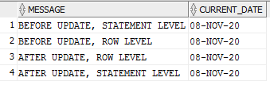
Output:

Slide 19
Transactions
A transaction is a sequence of one or more SQL statements that Oracle Database treats as a unit
When the application logic needs to execute a sequence of SQL commands in an atomic fashion, then the commands need to be grouped as a logical unit of work (LUW) called SQL transaction.
In everyday life, people conduct different kind of business transactions buying products, ordering travels, changing or canceling orders, buying tickets, paying rents, electricity bills, insurance invoices, etc.

Slide 20
Transactions
COMMIT Saves database transactions (save changes)
ROLLBACK Undoes database transactions (undoes changes)
SAVEPOINT Create save points (check points) within groups of transactions in which to ROLLBACK.
Transaction Commands are only used with DML commands, i.e., Insert, Update and Delete commands

Slide 21
Commit
Successful execution of the transaction is ended by a COMMIT command
Syntax:
COMMIT;

Slide 22
ROLLBACK
The ROLLBACK command is the transactional command used to undo transactions that have not already been saved to the database.
Syntax:
ROLLBACK;

Slide 23
Select * from products;
DELETE from products where product_id = 100;
RECORDS Deleted successfully
DELETE from products where product_id = 100; rollback;
DELETE from products where product_id = 100;
Commit;
DELETE from products where product_id = 100; rollback;

Slide 24
SAVEPOINT
A SAVEPOINT is a point in a transaction when you can roll the transaction back to a certain point without rolling back the entire transaction.
Syntax:
SAVEPOINT SAVEPOINT_NAME;
ROLLBACK TO SAVEPOINT_NAME;

Slide 25
Select * from product;
delete from product where product_id = 102;
savepoint sp1;
delete from product where product_id = 101;
savepoint sp2;
delete from product where product_id = 103;
savepoint sp3;
rollback to sp3;
rollback to sp2;
rollback to sp1;

Slide 26
Transaction Isolation Levels
Isolation determines how transaction integrity is visible to other users and systems.
Only one transaction is accessing the resource at a time (in a database system)
Defines the degree to which a transaction must be isolated from the data modification made by any other transaction.

Slide 27
Dirty read
Situation when a transaction reads a data that has not yet been committed.
You're permitted to read uncommitted, or dirty, data.
The meaning of this term is as bad as it sounds. You're permitted to read uncommitted, or dirty, data. You can achieve this effect by just opening an OS file that someone else is writing and reading whatever data happens to be there.

Slide 28
Nonrepeatable read
It simply means that when transaction reads same row twice and get different values each time.
Concurrency
This simply means that if you read a row at time T1 and try to reread that row at time T2, the row may have changed. It may have disappeared; it may have been updated, and so on.

Slide 29
Phantom read
This means that if you execute a query at time T1 and re-execute it at time T2, additional rows may have been added to the database, which may affect your results.
This means that if you execute a query at time T1 and re-execute it at time T2, additional rows may have been added to the database, which may affect your results.
This differs from a nonrepeatable read in that with a phantom read, data you already read hasn't been changed, but instead, more data satisfies your query criteria than before.

Slide 30
Based on these phenomenon, the SQL standard defines four isolation levels:
Read Committed
Read uncommitted
Repeatable Read
Serializable

Slide 31
Read committed
Read committed is an isolation level that guarantees that any data read is committed at the moment it is read.
Does not allows dirty read.
Read or write lock on current row.
Preventing other transactions

Slide 32
Read uncommitted
This is the lowest isolation level.
In this level, dirty reads are allowed, so one transaction may see not-yet-committed changes made by other transactions

Slide 33
Repeatable reads
Most restrictive isolation level
In this isolation level, a lock-based concurrency control DBMS implementation keeps read and write locks (acquired on selected data) until the end of the transaction
Read locks on all rows it reference.
Write locks on all rows it insert, update or delete.

Slide 34
Serializable
Highest isolation level.
With a lock-based concurrency control DBMS implementation, serializability requires read and write locks (acquired on selected data) to be released at the end of the transaction.
Serially executed

Slide 35
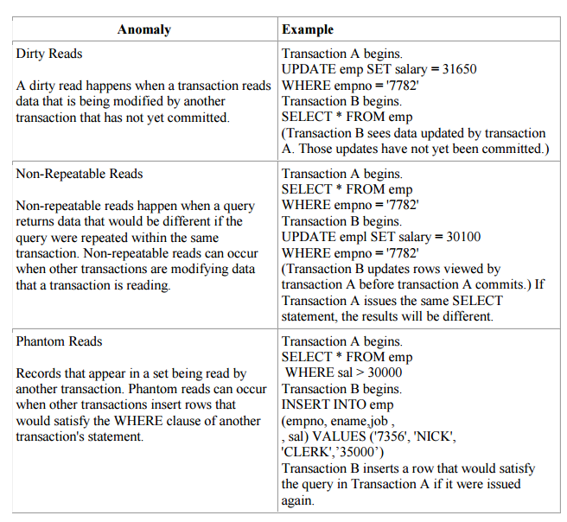

Slide 36
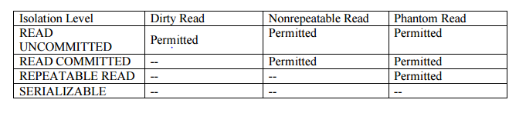

Slide 37
COMMAND TO SET ISOLATION LEVEL:
SET TRANSACTION ISOLATION LEVEL {SERIALIZABLE | READ COMMITTED};
SET TRANSACTION READ ONLY
Grant select, update, insert on TABLE to SYSTEM;

Slide 38
Statement-level trigger
A statement-level trigger is fired whenever a trigger event occurs on a table regardless of how many rows are affected.
In other words, a statement-level trigger executes once for each transaction. For example, if you update 1000 rows in a table, then a statement-level trigger on that table would only be executed once.

Slide 39
Row-level trigger
A row-level trigger fires each time a row is affected by a triggering event.
For example, if you update 1000 rows in a table, the trigger will fire 1000 times, which potentially cause a performance issue. To specify a condition of when to fire the trigger, you can use the WHEN clause.

